Slide 1
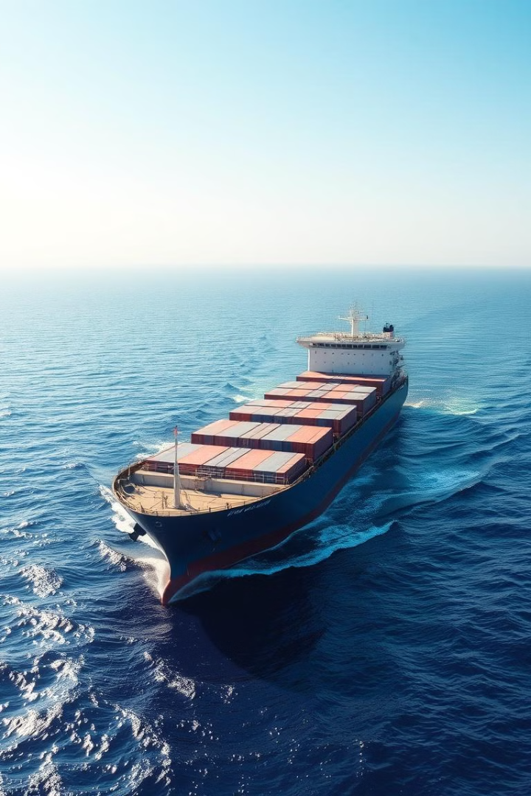
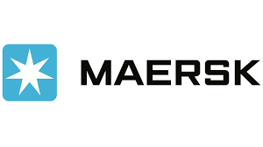
Operational Challenges in the Global Shipping Industry: A Case Study of Maersk
This presentation analyzes the operational challenges and solutions implemented by Maersk, a global leader in the shipping industry. We'll examine key operational processes, explore quality control methods, and delve into the impact of current challenges on Maersk's operations. We'll also showcase innovative strategies and technological advancements employed by the company to navigate these complex dynamics.

Slide 2
Maersk: A Global Logistics Leader
Business Activities
Key Facts
Shipping
Founded in 1904, headquartered in Copenhagen, Denmark.
Port operations
Supply chain management
Operates in 130 countries with over 100,000 employees.
Warehousing
2023 annual revenue: US$51.1 billion.

Slide 3
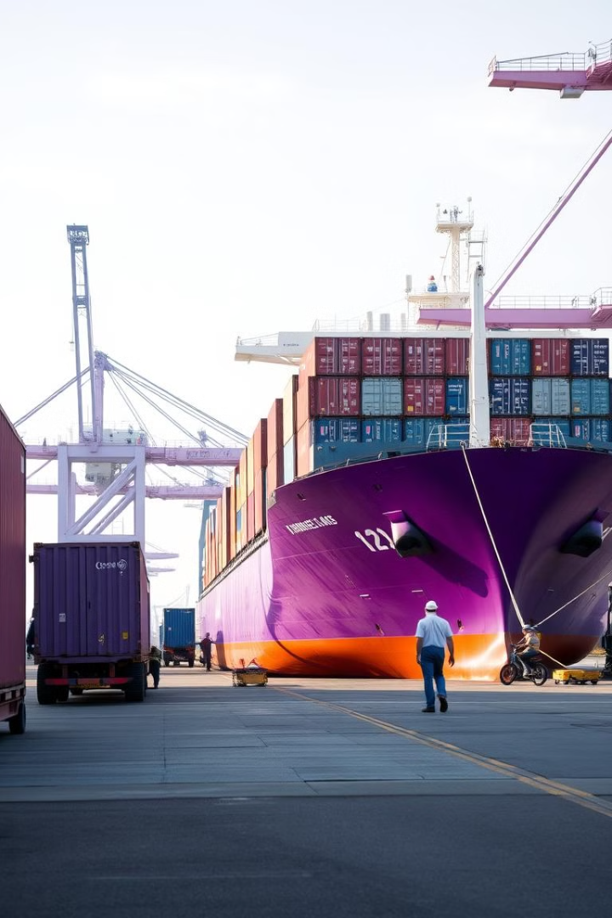
Key Operational Processes at Maersk
Ocean Freight
Inland Transportation
Maersk utilizes its vast fleet of container ships for international transport, offering flexible shipping options, advanced route planning, and fuel-efficient vessels.
Maersk provides intermodal transportation solutions, connecting ports with inland destinations through trucking, rail, and aircraft services.
Warehousing and Distribution
Maersk offers warehousing solutions for storage and inventory management across global facilities, including inventory tracking, demand forecasting, and just-in-time inventory systems.

Slide 4

Quality Control Methods at Maersk
ISO Certifications
Vendor and Supplier Quality Management
Maersk adheres to international standards for quality management, environmental management, and occupational health and safety management. It holds certifications like ISO 9001, ISO 14001, and ISO 45001.
Maersk maintains strict supplier evaluation and quality control measures, ensuring that all partners, vendors, and suppliers comply with its quality and safety standards.
Sustainability and Environmental Quality
Sustainability is a key focus for Maersk. The company has stringent quality standards for minimizing environmental impact, including adopting eco-friendly technologies and offering greener shipping options.

Slide 5
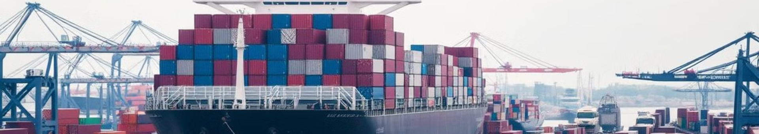




Operational Challenges Facing Maersk
Port Congestion
Rising Fuel Costs
Geopolitical Tensions
Supply Chain Instabilities
High cargo volumes, labor shortages, and limited port infrastructure lead to delays and increased operational costs.
The volatility of fuel prices, particularly low-sulfur fuel oil, has significantly increased Maersk’s operating expenses.
Tensions in conflict-prone regions, such as the Red Sea, disrupt key trade routes and increase transit times.
The pandemic's effects, including uneven recovery across global economies, continue to affect supply chains, creating inefficiencies.

Slide 6
Maersk's Response to Operational Challenges
1
Addressing Port Congestion
Investing in enhanced port operations through partnerships and digital tools for better scheduling and capacity management. Solutions like automated cranes and expanded warehousing near congested ports can reduce dwell times and improve efficiency.
2
Managing Rising Fuel Costs
Transitioning to alternative fuels like LNG, methanol, or biofuels to reduce reliance on costly traditional fuels. Maersk has already invested in dual-fuel vessels and can further explore energy-efficient ship designs.
3
Mitigating Geopolitical Disruptions
Establishing diversified shipping routes and regional hubs to avoid reliance on conflict-prone areas. Strengthening partnerships with governments and local port operators in strategic regions can also help mitigate geopolitical risks.
4
Improving Supply Chain Stability
Investing in predictive analytics and machine learning to anticipate and address supply chain bottlenecks. Building stronger relationships with suppliers and increasing container availability across key trade lanes can also help balance equipment supply and demand.
5
Strengthening Environmental Compliance
Expanding the fleet of eco-friendly vessels and increasing R&D investments in innovative technologies to achieve decarbonization goals. Maersk can leverage carbon credits and participate in global green initiatives to offset emissions while enhancing collaboration with regulatory bodies to stay ahead of compliance changes.

Slide 7




Maersk and IBM: A Blockchain Joint Venture
Shared Information
1
Focus on providing secure and paperless documentation and information sharing platform to the industry
Digital Products
2
The joint venture aims to create a platform for sharing information and developing digital products related to trade.
Blockchain Technology
3
The platform will leverage blockchain technology, along with other cloud-based open source technologies including artificial intelligence (AI), IoT, and analytics.
Global Trade Streamlining
4
This venture will empower companies to move and track goods digitally across international borders, helping to overcome challenges related to paper-based systems, supply chain visibility, and potential for corruption.

Slide 8
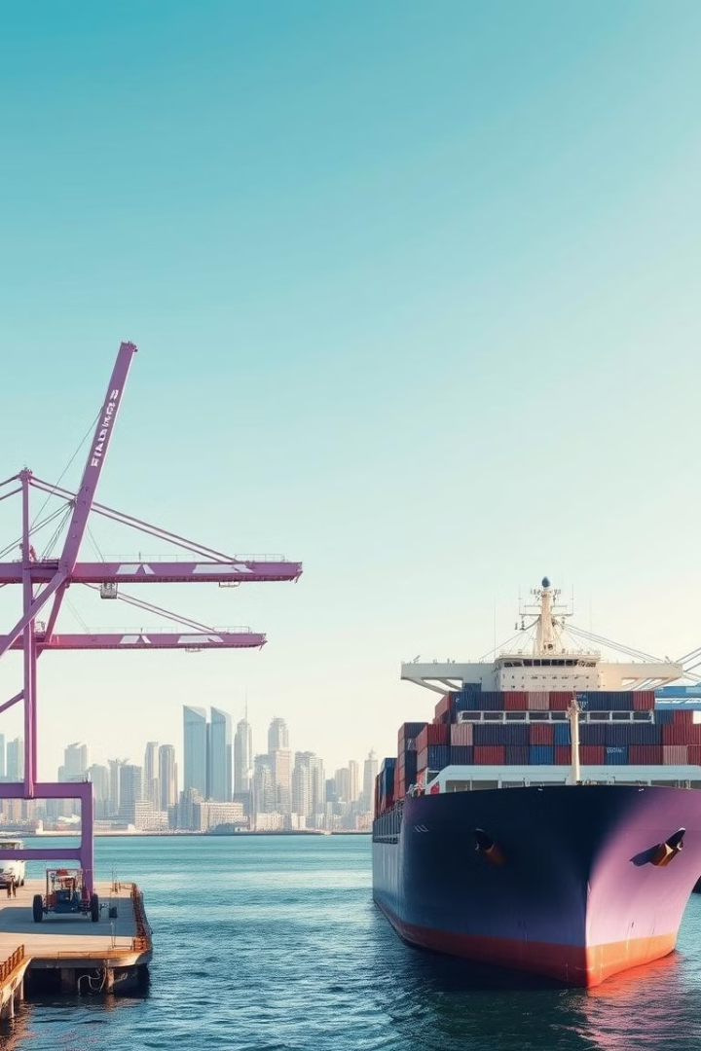
Key Goals of Maersk's Solutions
1
Efficiency
Maersk's solutions aims to achieve greater operational efficiency, reducing costs and maintaining its leadership in the shipping industry.
2
Sustainability
Proactive measures aligns with long-term goals of sustainability, profitability, and customer satisfaction. Maersk invests in eco-friendly vessels and fosters partnerships with governments and stakeholders.
3
Adaptability
Maersk's ability to remain agile and innovative will be critical for navigating uncertainties and sustaining its competitive edge.

Slide 9

Next Step: A Sustainable Future
Maersk's continued dedication to sustainability, technology, and innovation will be critical in ensuring a future where the global shipping industry remains efficient, resilient, and environmentally responsible. Maersk's commitment to navigating the complexities of global trade while contributing to a more sustainable future is a testament to its leadership in the shipping industry.

Slide 10
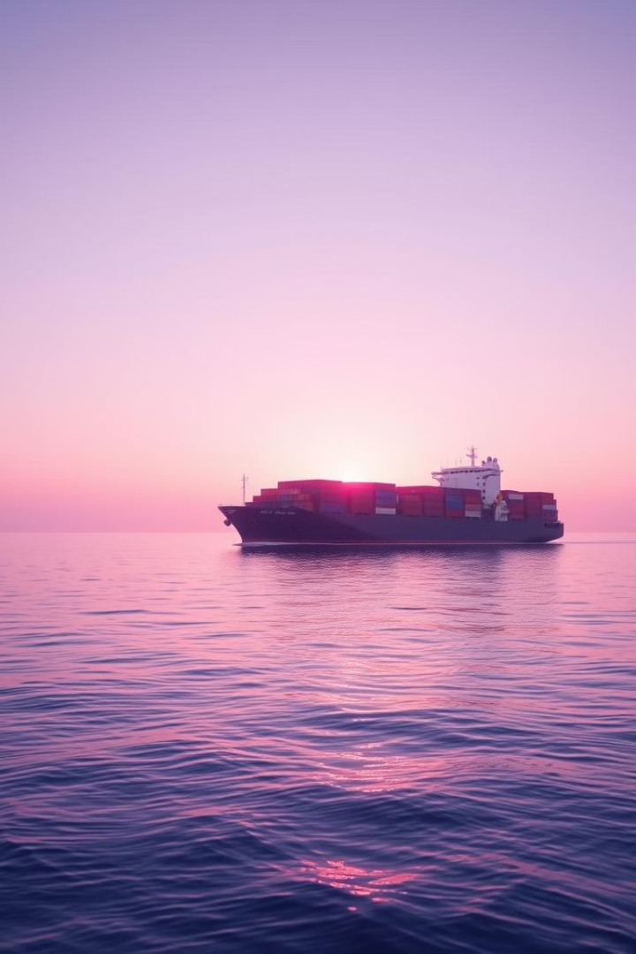
Conclusion: Driving Industry Leadership
Maersk's commitment to operational excellence, environmental stewardship, and technological innovation positions the company to navigate evolving market dynamics effectively. The company's comprehensive approach ensures that it not only addresses current challenges but also capitalizes on opportunities for growth and sustainability.

